Slide 1

Requirements Document for a Human Resources Management Information System
CMPG 213 – Group 1
For Pieta's Staffing Solutions and Training

Slide 2
Table of Contents
Project Plan
Definitions, Acronyms, and Abbreviations
Project Description and Scope
Functional Requirements
Business data requirements
Business processes requirements
Business interface requirements
Non-functional Requirements
Candidate Systems Matrix
Feasibility Analysis Matrix
Use-Case Glossary and Use-Case Model Diagram
Fact-finding Techniques and Outcomes
Summary and Further Planning

Slide 3
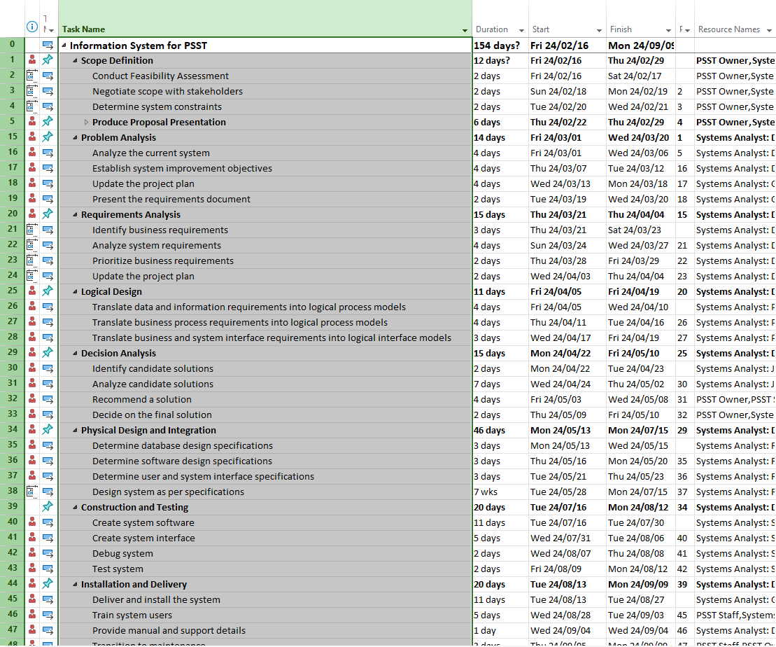
1. Project Plan

Slide 4
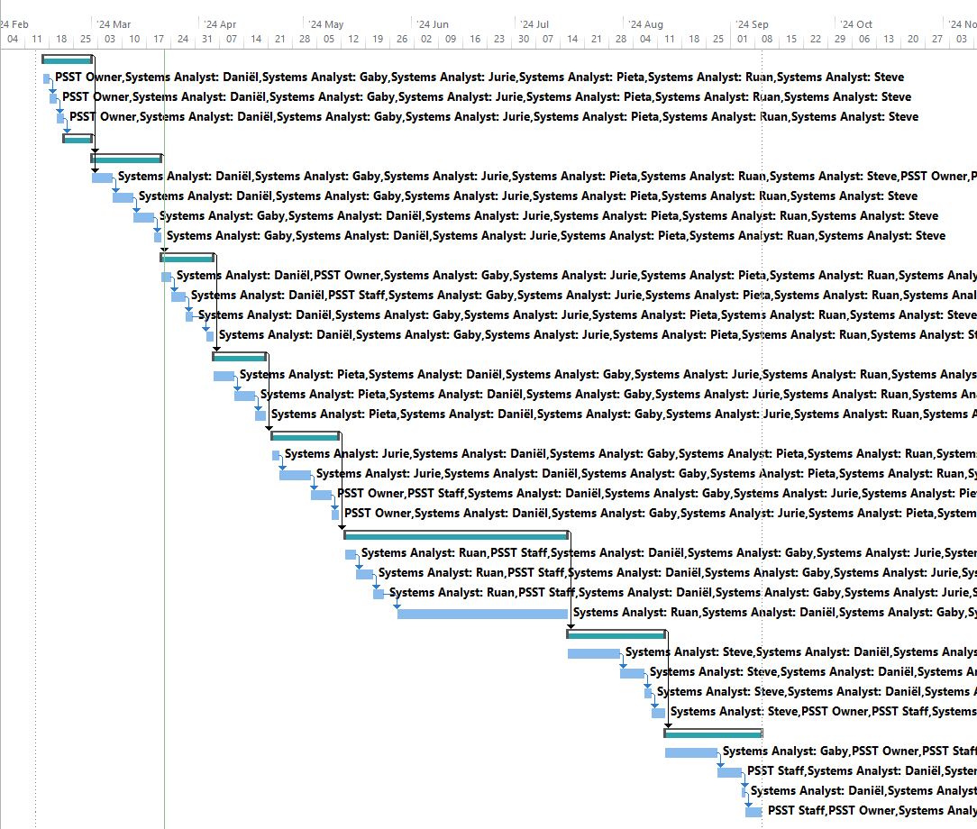
1. Project Plan

Slide 5
2. Definitions, Acronyms, and Abbreviations
Abbreviations
• PERT Chart: Program Evaluation Review Technique Chart
• GUI: Graphical User Interface
• COTS: Commercial Off-The-Shelf
• EST: Earliest Start Time
• LCT: Latest Completion Time
• PSST: Pietas Staffing Solutions and Training
• HR: Human Resources
• DB: Database
Definitions
• GANTT Chart: A bar chart that is used to illustrate a project schedule. The tasks are placed on the vertical axis with the time needed for each phase being put on the horizontal axis.
• PERT Chart: A tool used to plan, organize, schedule and coordinate tasks within a project

Slide 6
3. Project Description and Scope
Pieta’s Staffing Solutions and Training (PSST) is a human resources company in South Africa with the functions of recruitment, staffing, training, and other human resources functions. Jobs are created by clients of PSST and staff (resources) who were onboarded previously by PSST are outsourced to complete their specialized tasks in those roles. After staff (resources) are placed, their leave, pay, and time worked are recorded. PSST mostly obtains government projects and, as such, does not quote but only invoices their clients.

Slide 7
3. Project Description and Scope
The system must satisfy the following functional requirements:
Maintenance of jobs/positions.
Maintenance of staff resources (current placement, availability, etc.).
Maintenance of invoices.
Maintenance of clients (those with jobs needing to be filled).
Logging and reporting of time worked.
Recording salaries and wages.
Reporting such as transaction over a period, number of staff (resources), number of hours staff (resources) worked, open positions/jobs, and other management information reports.

Slide 8
3. Project Description and Scope
In addition, the system must satisfy the following non-functional requirements:
Database queries shouldn’t take more than 5 seconds
Multiple Clients, resources, invoices, growth of new clients and new resources a year.
Assistance functionality (e.g. self-help and how to).
Provide unique identifiers (e.g. username and password) for each user to secure access to the system.
An implementation of a help feature will be added.
The system will be used by two types of users. All functionality will be accessible to an administrator, and only certain functionality will be accessible to regular users.
Development and maintenance of the project will be cost effective and economically viable.

Slide 9
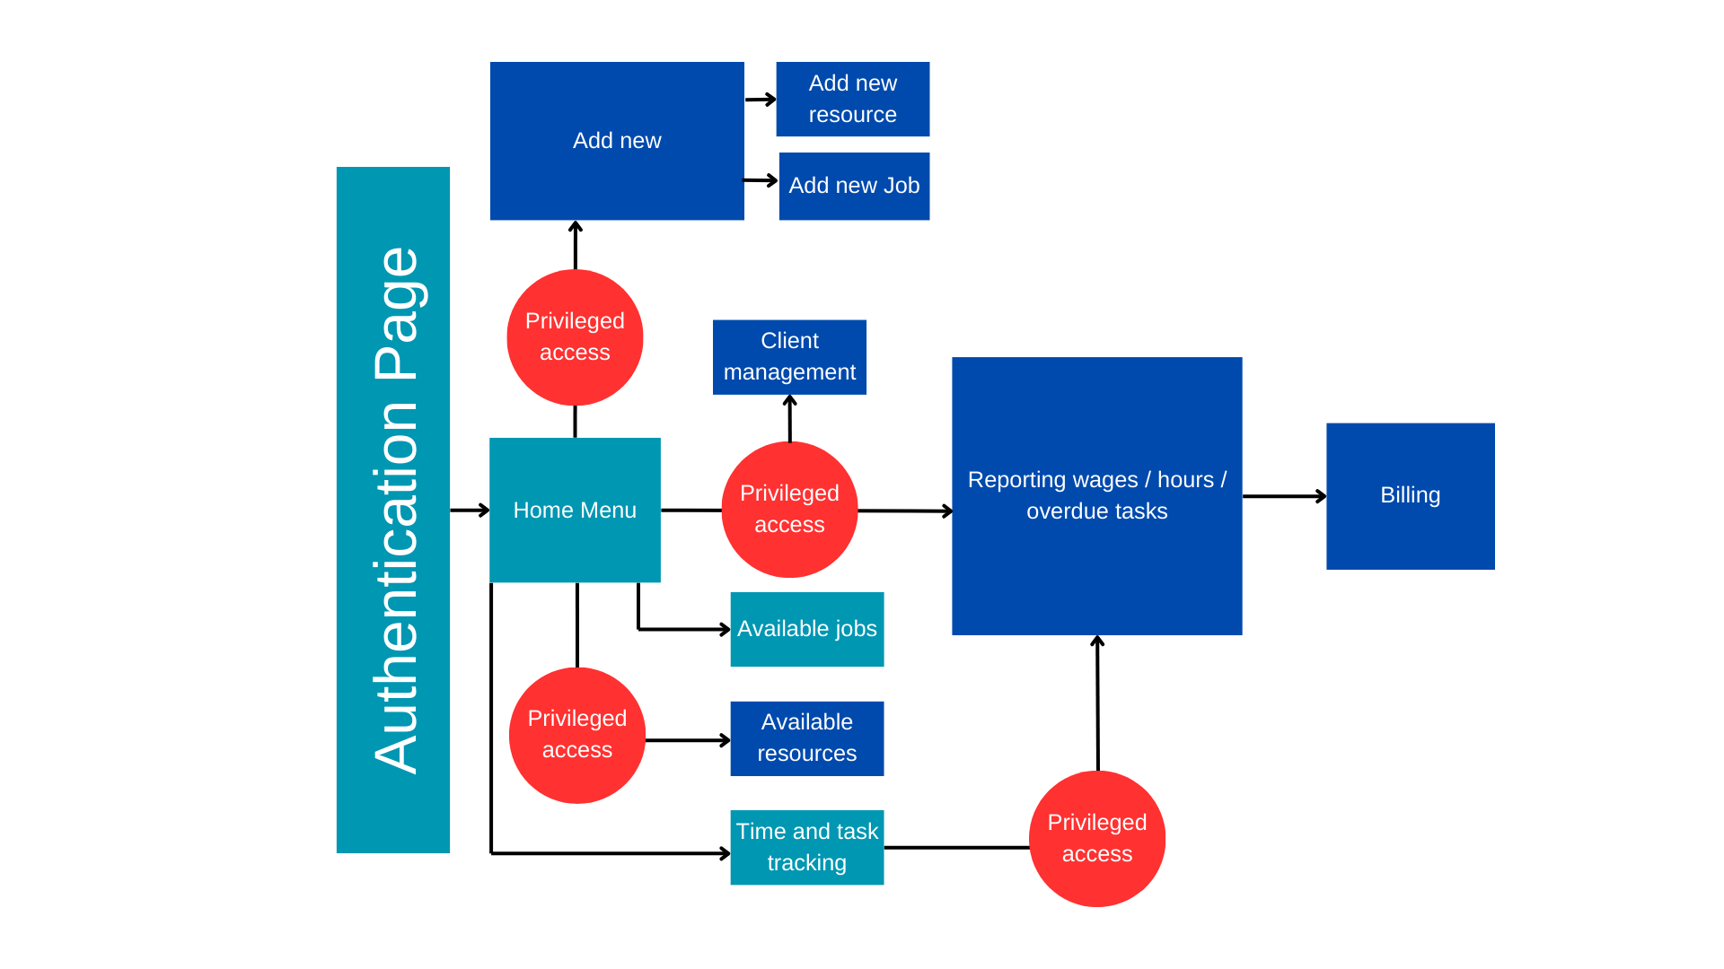
4. Graphical user interface requirements

Slide 10
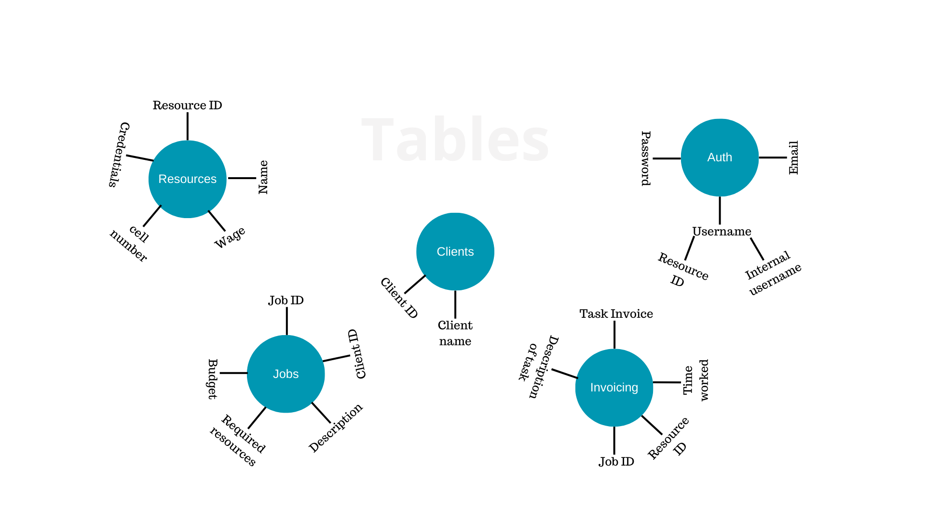
Database Design (Proposed)

Slide 11
4. Functional data, process & interface requirements
Maintenance of jobs/positions
Add new job
Input | Process | Output
Client name* Job name* Requirements/Description Budget * Denotes mandatory fields | If project name already exists show warning message. Validate that all mandatory(*) fields have been entered and are in the correct format. Generate Job ID. Add data to jobs table. Search matching resource from resources table. | Job ID Resource ID (If compatible available resource is found) Resource Qualifications. If item was successfully added, show success message otherwise show error message.

Slide 12
4. Functional data, process & interface requirements
Maintenance of jobs/positions
Maintain job
Input | Process | Output
Job ID* Budget Requirement Name Remove job | Apply validation for new input fields. Field is "enabled" when user chooses what field needs to be updated. Removes job from jobs table if applicable field is selected. Apply change to jobs table. | Job ID Success message if updated successfully or error message if not.

Slide 13
4. Functional data, process & interface requirements
Maintenance of staff resources
Add new resource
Input | Process | Output
Resource name* Resource surname* Resource email* Resource cellphone number* Qualifications and skills*. Hourly wage | Generates resource ID. Validates whether resource with the same information (email & cellphone) exists. Add the resource details to the resource table. Assign relevant qualifications or certifications. Creates password in authentication table | If similar resource does not exist show resource ID and list of all possible job openings that fits criteria (requirements). Success message if added successfully, otherwise show an error message.

Slide 14
4. Functional data, process & interface requirements
Maintenance of staff resources
Maintain resource
Input | Process | Output
Resource ID* Email Cellphone number Qualifications and skills. Hourly wage Field to update and New value for the selected field New password for authentication Remove resource. | Apply validation for the "email", "name", "hourly wage" and "cellphone" fields. Field is "enabled" when user chooses what field needs to be updated Allow password reset for authentication – if filled out Update information in resource table | Show recourse with changed information (excluding new/existing password). If information has been successfully changed in database show success message otherwise show error message.

Slide 15
4. Functional data, process & interface requirements
Maintenance of invoicing
Create new invoice
Input | Process | Output
Job ID* | Get Client name and Description from jobs table. Get Resource Name, Time Worked and Description of Task from invoicing table. Get Invoice Amount from invoicing table. | Client name. Job description Resource ID, Description of task and Time worked. Invoice amount.

Slide 16
4. Functional data, process & interface requirements
Logging & reporting time worked
Time and task tracking
Input | Process | Output
Resources: Resource ID* Job ID* Time worked* Description of task* Admin staff: Job ID* | Validates job ID from jobs table. Validates user input Add description of task, time worked to invoicing table. Get Wage from resource table Write calculated Task Invoice (hours worked * (Wage * 1.5)) to invoice table | Resources: - Job ID. - Description. - Time worked. - Payable wage (Wage * hours worked) Admin: - Job ID - Total time spent on job. - Total amount to bill client (Sum of all Task Invoice amounts) - Job budget

Slide 17
4. Functional data, process & interface requirements
Reporting
Landing
Input | Process | Output
The Date Range The Type of report | Get wages from resources table to show total wages. Get total hours worked from jobs table to show total hours worked. Get job ID from jobs table of all overdue jobs | Total billing cycle wages Total hours worked by all resources Highlighted job ID of overdue jobs.

Slide 18
4. Functional data, process & interface requirements
Reporting
Wages
Input | Process | Output
Resource ID* The date range and Payroll Period Salary Information (Basic Salary, Overtime, Bonuses) | Pulls wages information from resources table Calculate the total wages based on the information. Remove Deductibles, such as taxes. Create pay slips for each employee Ensure legal requirements, A.K.A. minimum wage. | Display amount owed to employee(s) Display employee personal information. Optional – Display jobs worked by employee for the billing cycle. Summary report with total wages.

Slide 19
5. Non-functional requirements
Requirements | PIECES categories
Individual queries to not take more than 5 seconds | Performance
Approx 25 Clients, 50 resources with 15 invoices per month, Growth of 10 new clients per year and 35 new resources a year | Information & Data
Assistance functionality | Efficiency of people and processes
There will be 2 types of users: Admin, which will have full access to the entire app and resources which will only have access to certain features | Control or Security
Development and maintenance of the project must be cost effective and economically viable. | Economic
Provide unique credentials for each user to ensure secure system access | Security

Slide 20
6. Candidate Systems Matrix
Characteristics | Candidate 1 As-Is | Candidate 2 Proprietary Software Package | Candidate 3 Custom-Designed Solution
Portion of human resources management and recruitment functionality covered | Paper-based system covering all functionalities physically without any computerization. | Will only cover some basic administration functionalities, without being able to handle salaries and days-off. | Covers all functionality with the potential to cover any new functions added.
Benefits | Low cost Currently functions Staff are familiar with system | Quick implementation Doesn't require much time commitment to implement Extended support with updates | Designed to meet all needs Can be adapted to meet future requirements and needs Facilitates easier transition from paper-based to computerization
Additional software | None. | Uses Microsoft Azure and requires Microsoft Windows or MacOS PC. | Requires Microsoft Windows and connects to a cloud database.
Servers and Workstations | None. | Requires PC with entry-level performance and basic networking. | Requires PC with entry-level performance and basic networking.
Software Tools Required | None. | A web browser such as Chrome or Edge. | Any Microsoft Windows PC with Visual C++ and other libraries.
Data Processing Method | Information is written on paper and stored in alphabetically-sorted cabinets for later retrieval. | Data is entered into the software hosted on Microsoft Azure server and reports are outputted via printed reports. | Data is entered on the PC locally and stored in a cloud database to facilitate business functionality and advanced reporting.

Slide 21
6. Candidate Systems Matrix
Characteristics | Candidate 1 As-Is | Candidate 2 Proprietary Software Package | Candidate 3 Custom-Designed Solution
Application Software | None. | Purchased as a white-label software package to be used. | Workstation PC should have Microsoft Windows already installed. Microsoft Visual Studio and related software must be purchased. Database software is included. The custom solution will provide functionality for all requirements and processes and will be built from the ground-up by the developers.
Output Devices and Implications | None. | Outputs are displayed in the web browser window and may be printed too. | Outputs such as reports are displayed on the application window and can be customized specifically to meet requirements and printed as well.
Input Devices and Implications | None. | Inputs are taken from the keyboard and mouse. | Inputs are taken from the keyboard and mouse as well as the scanner device.
Storage Devices and Implications | None. | Data is stored on the server, and doesn't require physical, local hardware. Data is backed-up to the cloud. | Application accessed via a local PC connecting to a cloud-based database.
Output Software | None. | Adobe Acrobat to display PDF reports. | Reports are displayed in the software itself and can be linked with other software.

Slide 22
7. Feasibility Analysis Matrix
Description | Wt. | Candidate 1 As-Is | Candidate 2 Proprietary Software Package | Candidate 3 Custom-Designed Solution
Technical feasibility | 20 | This candidate can be used, but it cannot be changed by the project team. Score: 0 | This candidate can be implemented but the project team have not had extensive training with the software and will not be able to efficiently maintain or repair the system. Score: 45 | This candidate will be programmed in a language and database software that is well-known by the project team. The project team’s members have the required knowledge to develop and maintain the system. Score: 90

Slide 23
7. Feasibility Analysis Matrix
Description | Wt. | Candidate 1 As-Is | Candidate 2 Proprietary Software Package | Candidate 3 Custom-Designed Solution
Operational feasibility | 10 | The current system fulfills basic requirements for the user but is analog, outdated and volatile. It does not store data effectively and there is no current formal system for staff management. This candidate is time consuming and losses data making it inefficient and frustrating for the user. Score: 30 | This candidate will fulfill most of the system users' requirements except for the invoicing system This candidate will include no double booking, ensure indefinite data storage and correct resource remuneration. Users may find it difficult to learn how to use the system due to its complexity. Score: 70 | This candidate meets all requirements of candidate 2 however will fulfill all user requirements by ensuring no double bookings, ensure indefinite data storage, correct resource remuneration. The candidate will also automate the invoicing system which will mitigate writing errors, mishaps in invoicing, and manual VAT calculation. Score: 85

Slide 24
7. Feasibility Analysis Matrix
Description | Wt. | Candidate 1 As-Is | Candidate 2 Proprietary Software Package | Candidate 3 Custom-Designed Solution
Risk feasibility | 20 | This candidate uses an analog system for storing data which can result in damage or loss of data. Score: 0 | There is a large chance that the implementation and adjustment of the candidates' system will be unsuccessful as the technologies are unfamiliar to the project team. A security concern was raised due to the programming language used. Score: 20 | The software and programming language utilized to build the system are areas in which the project team has a great deal of expertise. The implementation success of this system is high. Score: 90

Slide 25
7. Feasibility Analysis Matrix
Description | Wt. | Candidate 1 As-Is | Candidate 2 Proprietary Software Package | Candidate 3 Custom-Designed Solution
Economic feasibility The cost to develop: Payback period: Net present value: Detailed calculation | 20 | N/A N/A N/A N/A Score: 100% | Approximately R1 549 000 per year, R15 490 000 total after 10 years The entire project's life cycle is expected to be 10 years. (click here) Score: 21% | Approximately R5 994 000 An indefinite period of time. The system is an investment. (click here) Score: 69%

Slide 26
7. Feasibility Analysis Matrix
Description | Wt. | Candidate 1 As-Is | Candidate 2 Proprietary Software Package | Candidate 3 Custom-Designed Solution
Schedule feasibility | 10 | This requires no change in the current system. Score: 100 | The team is not confident in their skills with the programming language and software used, thus, the candidate cannot guarantee that the system will be completed within the scheduled time. (~2 months needed) Score: 80 | This candidate expects the project team to create elements such as interfaces, databases, and more from scratch, the system will likely be completed in the scheduled time. (~7 months needed) Score: 40

Slide 27
7. Feasibility Analysis Matrix
Description | Wt. | Candidate 1 As-Is | Candidate 2 Proprietary Software Package | Candidate 3 Custom-Designed Solution
Cultural feasibility | 10 | The users are unsatisfied with the current solution. Score: 0 | The users may show less opposition to this candidate but may still be intimidated by a completely foreign system. Score: 70 | The users could be opposed to this candidate. This can be mitigated by fitting the system to their needs and preferences as well as by providing continuous training. Scope/requirements can be adjusted based on feedback. Score: 70

Slide 28
7. Feasibility Analysis Matrix
Description | Wt. | Candidate 1 As-Is | Candidate 2 Proprietary Software Package | Candidate 3 Custom-Designed Solution
Legal Feasibility | 10 | Loss of Personal Information due to mismanagement of paper trail. Score: 35 | This candidate system may handle data compliance in ways that are not in line with the company's policies. The candidate does however provide insurance on legal costs. Score: 90 | There are no foreseeable legal problems with this candidate. Score: 100
Weighted feasibility | 100% | 36.5% | 48.2% | 79.3%

Slide 29
8. Use-case glossary
Name | Description | Participating roles
Authentication | The event where the user is authenticated via username/email and password to gain access to the system. | Admin & Resources
Maintain jobs | The event where a new job can be created (a new client will be created if a client doesn’t exist already), and an existing job can be changed or deleted. | Admin
Maintain resources | The event where a new resource can be created, and existing resources can be changed or deleted. | Admin
Maintain clients | The event where a client can be created, changed, or removed.
Available jobs | This event shows all the available jobs and requirements. | Admin & Resources
Available resources | This event shows all the available resources and qualifications, as well as allows details of an already existing resource to be changed or a resource can be deleted from the database. | Admin

Slide 30
8. Use-case glossary
Name | Description | Participating roles
Log time and describe completed tasks | This event updates the time spent on a certain job as well as providing a description of task. | Admin & Resources
Reporting - Wages | This event shows the total amount to pay to all resources as well as the amount of time spent working on certain jobs. | Admin
Reporting – Budget-exceeding jobs | This event shows all the jobs that have exceeded their budget amount. | Admin
Generate invoice for clients | This event generates an invoice for the client with client name, job description, resource name, task description and total invoice amount. | Admin

Slide 31
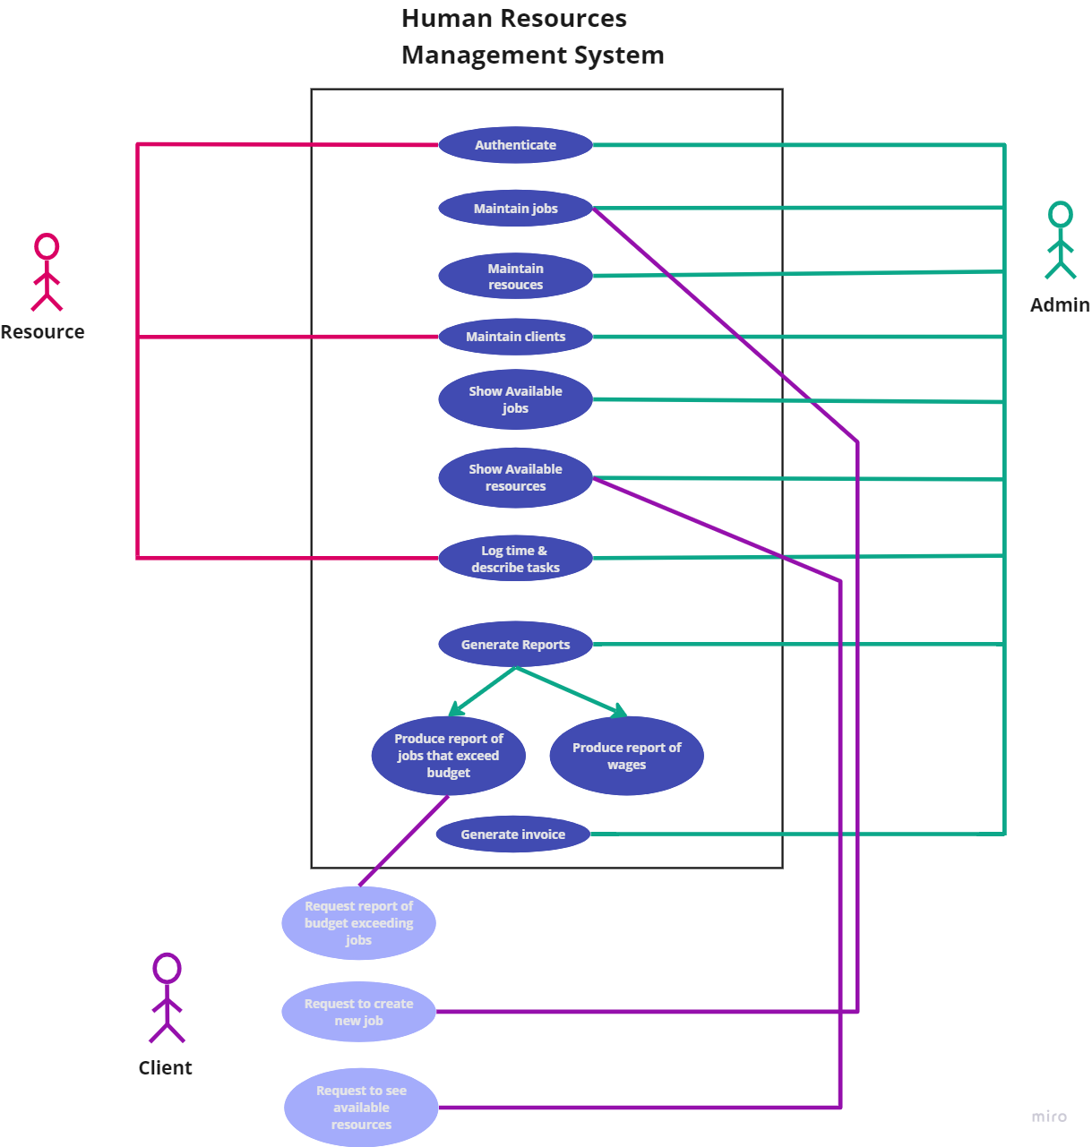
8. Use-case model diagram

Slide 32
9. Interview for system development
Interviewee: CEO – Pieta; HR Manager – Sonel Wilner; Training Coordinator – Mohaule Owens; and 3 System Users
Location: Brakpan, Johannesburg
Time: 14:30
Date: 14 / 02 / 2024
Goal of the interview: Identify system issues and gather user requirements
Time Allocated | Interview question/ Action | User response
2 min | State the reason for the interview to the interviewee.
4 min | Which system is currently used in the company for Human Resource Management? | The company uses a manual system to record information. The manual system uses a lot of papers, thus making it prone to being dysfunctional.
4 min | Which of the current shortcomings of your system do you hope the newly developed system will address? | The system is currently incredibly time consuming and labor intensive.
4 min | If we develop and implement a system for you, would you be willing to pay us to monitor the system and provide continuous updates; where needed. | The Business: Pieta's Staffing Solutions and Training were willing to pay a fee, if the fee is reasonable.

Slide 33
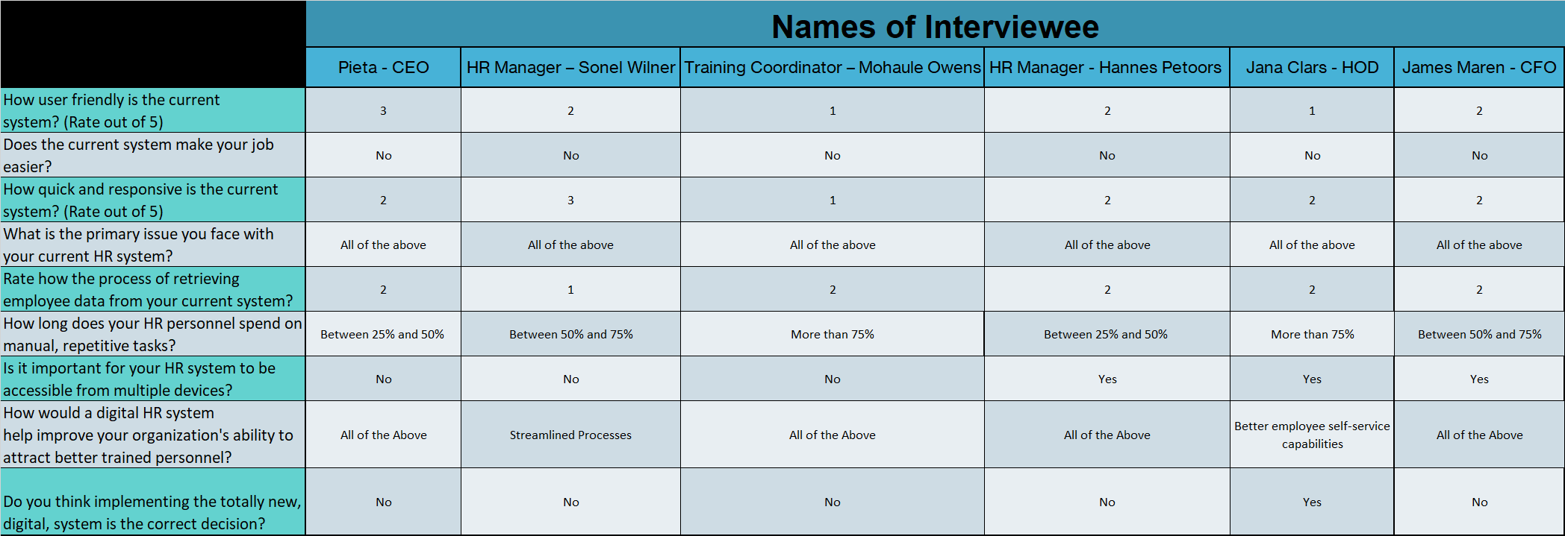
9. Questionnaires

Slide 34
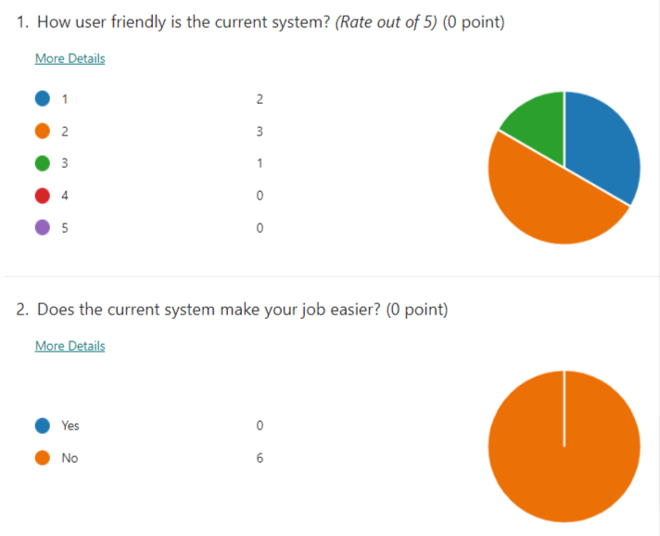
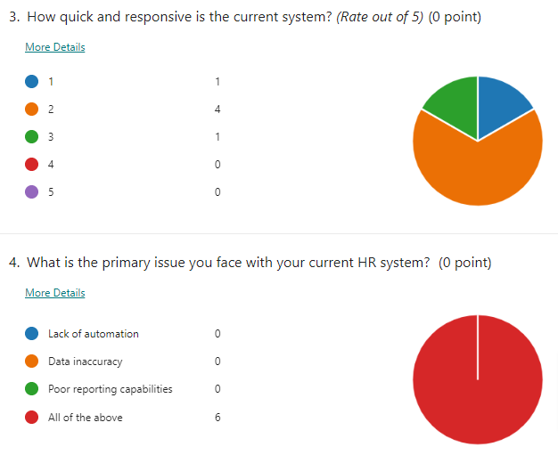
9. Summary Of Findings

Slide 35
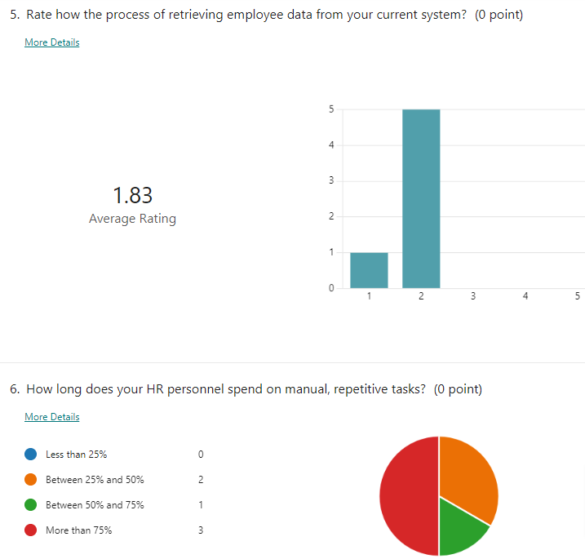
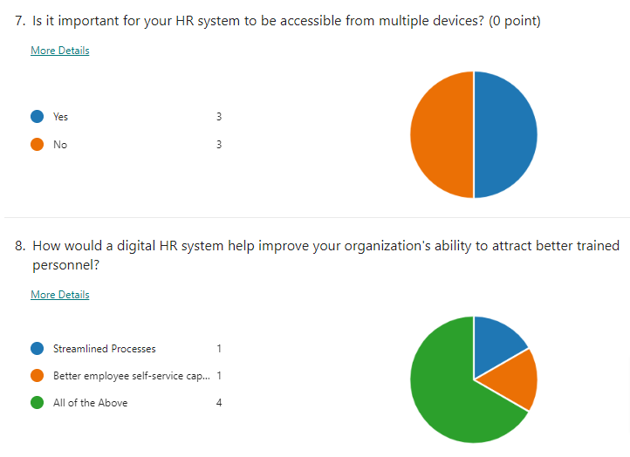
9. Summary Of Findings

Slide 36
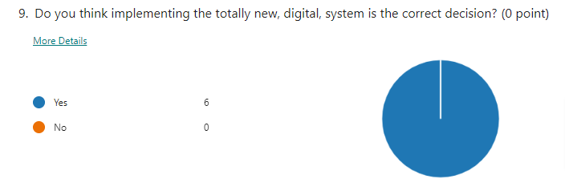
9. Summary Of Findings

Slide 37
10. Summary and Further Planning
This document covered the requirements for a Human Resources Management Information system.
This concludes the Requirements Analysis Phase for the project.
The Scope Definition, Problem Analysis and Requirements Analysis phases of the project have now been compiled.
After the acceptance of this document, the project team can proceed with the Logical Design phase of the project until 9 September 2024.

Slide 38
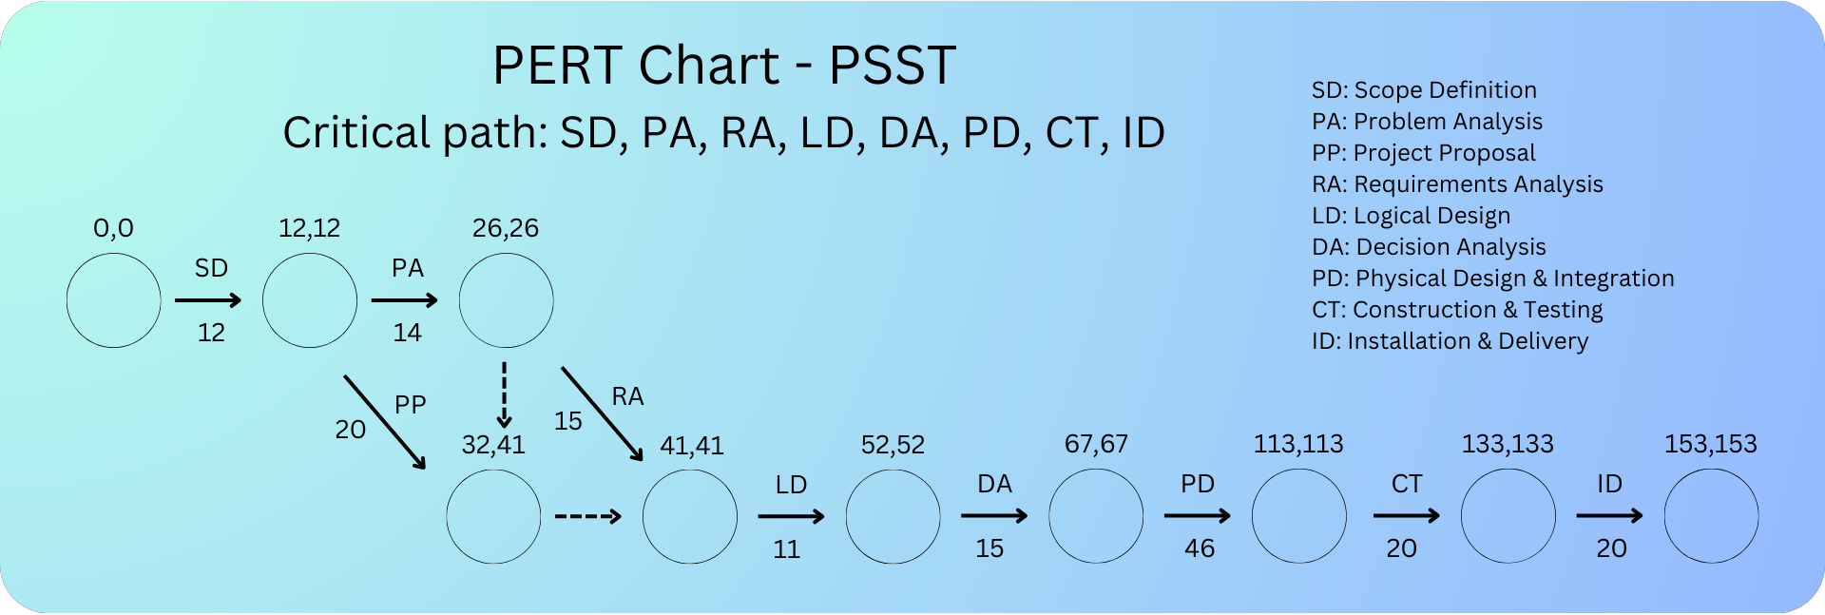
10. Summary and Further Planning

